Slide 1
Python Classes and Objects
DVT101 – Lecture 36
- By Dataverse Tutorials

Slide 2
Introduction to Python OOP
What is Object-Oriented Programming
Why OOP is important in Python
Real-world mapping with code
How OOP improves large projects

Slide 3
What is a Class
Meaning of a class as a blueprint
How a class defines structure
Relationship between class and objects
Reusability through classes

Slide 4
What is an Object
Object as an instance of a class
Object state, behavior, identity
Multiple objects from one class
Real-world analogy

Slide 5

Class Attributes
Attributes defined at class level
Shared across all objects
When to use class variables
Memory and behavior impact

Slide 6
Instance Attributes
Attributes unique to each object
Created at object initialization
Difference from class attributes
Data encapsulation concept

Slide 7
Constructor (init) Concept
Role of constructor
Automatic execution on object creation
Initializing object state
Passing values at runtime

Slide 8
self Keyword & Object Identity
Meaning of self
How Python binds object reference
Accessing instance data
Why self is mandatory

Slide 9
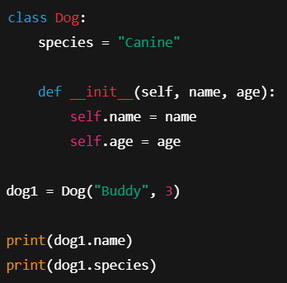
Creating Objects (Instantiation)
How objects are created from class
Memory allocation process
Object reference variables
Lifecycle of an object

Slide 10
Accessing Attributes & Methods
Dot operator working
Difference between class and instance access
Attribute lookup order
Read vs write access

Slide 11
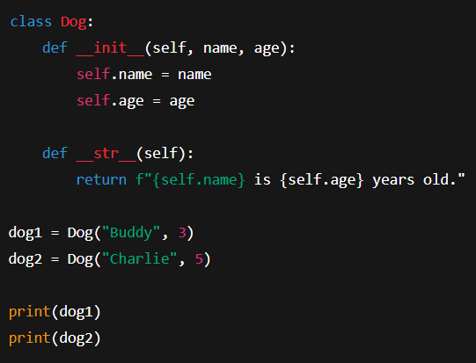
str() Method Concept
Purpose of string representation
Default vs custom behavior
How Python calls str()
Improving debugging and logs

Slide 12
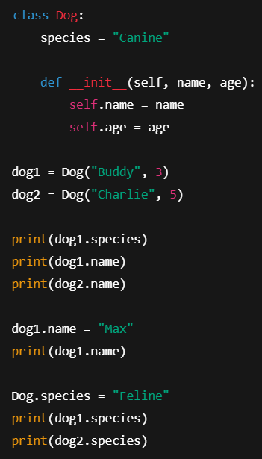
Class vs Instance Variables
Shared vs unique data
Scope and lifetime
How overriding works
Real-world mapping

Slide 13
Variable Resolution Order
How Python finds attributes
Instance namespace
Class namespace
Inheritance lookup idea

Slide 14
Memory Model of Objects
Heap storage for objects
References and identity
Garbage collection idea
Why memory matters

Slide 15
Real-World Industry Use
Web frameworks (models)
Game development entities
Machine learning pipelines
Enterprise systems

Slide 16
Common Mistakes with Classes
Forgetting self
Misusing class variables
Overwriting attributes
Debugging tips

Slide 17
Best Practices in OOP
Naming conventions
Keeping classes small
Clear responsibility
Documentation habits

Slide 18
When to Use Classes
Data + behavior grouping
Reusability
Maintainability
Team-based coding

Slide 19
OOP vs Procedural Style
Structural difference
Scalability comparison
Code readability
Industry preference

Slide 20
Summary of Key Concepts
Class, object, constructor
Attributes and self
str method
Class vs instance variables

Slide 21
Learning Path Forward
Practice suggestions
Mini project ideas
Next OOP topics
Career relevance

Slide 22


